Slide 1
Construction Prequalification & Prebid Questions/Addenda
Adam Kieffer
Construction Prebid and Prequalification Coordinator
Office of Contract Sales

Slide 2
Agenda
Construction Prequal
Work Type 26 Revisions
New Search for Prequalified Contractors
Proposed C-95 Policy Revisions
Intro to Prebid Questions/Addenda

Slide 3
Contractor Prequalification

Slide 4
Work Type 26 Revisions
Certification. The Contractor must possess SSPC QP 1 Certification (Field Application to Complex Industrial and Marine Structures) and SSPC QP 2 Certification (Field Removal of Hazardous Coatings) by the Society For Protective Coatings
Effective 7/1/16.
Any Contractor without both certifications will have WT26 removed from their Prequal Cert
www.sspc.org

Slide 5
Prequalified Contractor List

Slide 6
www.transportation.ohio.gov/contracts

Slide 8
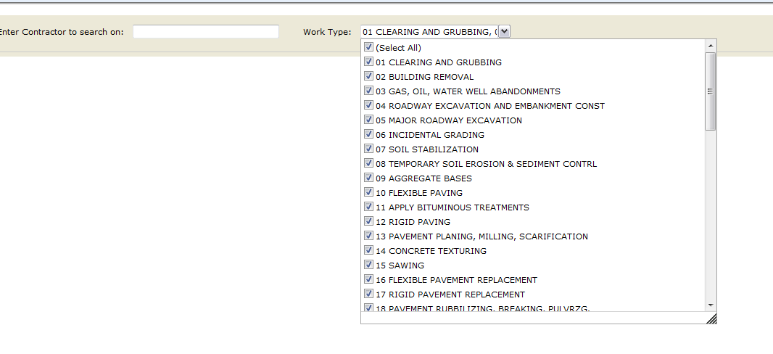

Slide 9
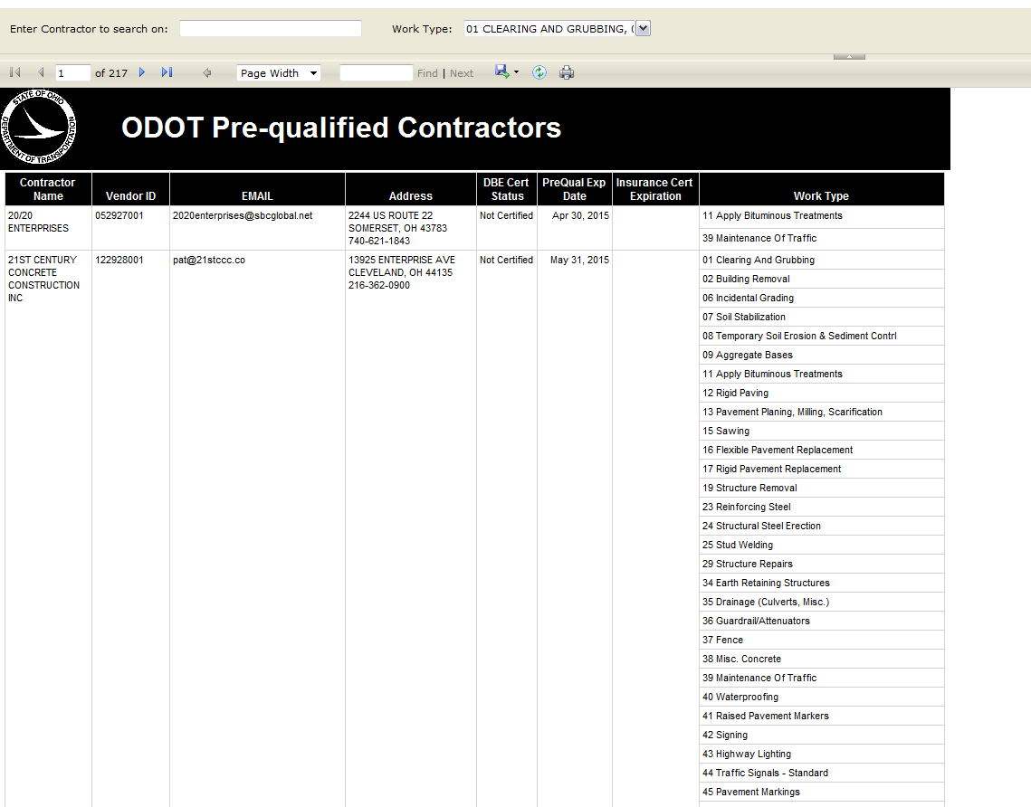

Slide 10
Proposed Revisions to C-95 SOP

Slide 11
Proposed Updates
References to CMS updated to Sitemanager
Appendices updated to reflect SM questions
Ratings guidelines as well.
Subcontractors can be Autoevaluated
Default score of “10.”
Any sub not deserving of a 10 should be formally evaluated.
Delivery of evals to contractor electronically.

Slide 12
Ratings
Required Questions
10, 8, 5, or 1
Optional Questions
10, 8, 5, 1, or N/A
5’s and 1’s require comments
5’s must be justified by notes in SM, daily work reports, progress meetings, etc.
1’s – written notice of deficiencies shall have been presented to contractor during life of project.

Slide 13
Bidding Capacity
Nominal ratings presently 10’s
Enforce ratings as per guidelines.
8 becomes nominal score.
10 is for going above and beyond.
Not new, enforcing existing policy per the ratings guidlines.

Slide 14
Prequalification Factor
Present rating system
Proposed Rating System
Average Rating | Prequalification Factor
85% | 10
80% - 84% | 9
70% - 79% | 8
60% - 69% | 7
55% - 59% | 6
50% - 54% | 5
Below 50% | 1
Average Rating | Prequalification Factor
≥75% | 10
70% - 74% | 9
65% - 69% | 8
60% - 64% | 7
55% - 59% | 6
50% - 54% | 5
Below 50% | 1

Slide 15
Appeals Process
Notify Prequal Coordinator in writing within 10 days.
Seek Clarification/Attempt to resolve with Project
Attempt to resolve with DCA
Appeal to PQRB
Provide evidence of position; may or may not involve formal hearing.
Appeal to Franklin County Court of Common Pleas.

Slide 16
Prebid Questions & Addenda Intro

Slide 17
www.transportation.ohio.gov/contracts

Slide 18
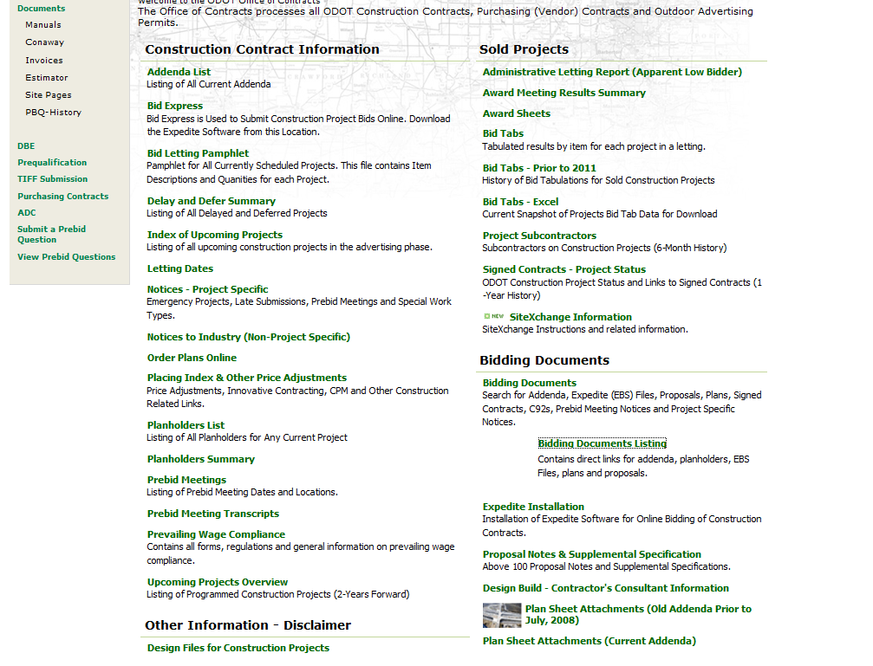

Slide 19
Prebid Questions and Addenda
SOP 510-020(SP)
Guidelines for PBQ &Addenda
All prospective bidders have access to same information; fair and competitive bid
PBQs: Advertising Phase until 10am 4 days before opening
Notes:
Over last year, many changes to the prebid process
Elecronically submitted; automatically diverted to responsible District – helps speed getting question to the right place. And enables us to get a response to you MORE QUICKLY
In January of 2014 published new SOP
Established a procedure for the automated process and targets/timeframes for the process.
Sell many unique projects that often have many unique circumstances. Are we always going to hit the deadlines in SOP?? NO!! Will do our best to do so!
Ultimately though, our priority is for all prospective bidders to have access to the same information as expeditiously as possible
And have fair and competitive bid.
THIS WE WILL NOT COMPROMISE
PBQ’s Advertising phase (typically 5 weeks) until (Deadline) 10am 4 working days before letting
Most lettings Thursday, so the cutoff is typically the Friday before (so does that mean we ignore PBQs after deadline?)
Late PBQ’s: District must still evaluate
Delays close to Letting are not ideal; several on the last few lettings, most because of evaluating late Prebid Questions & subsequent Addenda.
Most delays close to lettings are so that Addenda could be processed/published to give prospective bidders fair opportunity to process/evaluate their bid based on the Addenda.

Slide 20
Notes:
To submit PBQ, click “Submit a Prebid Question” on left.

Slide 21
Notes:
PROJ # is NOT pid typically 14XXXX (to find corresponding construction project #, visit “index of upcoming projects” on contract sales website
Fill out all fields so I can contact if problem. Wrong project, more clarification, etc.

Slide 22
Notes:
To view your PBQ, click “VIEW PBQs”

Slide 23
Notes:
Report is automatically refreshed every 15 minutes, time date on bottom of each page. If not call me.
Sorted by Proj number. (Type in Construciton Proj # in “find” field.)
Questions are sorted by last in at the top.
The date/time stamp is the unique identifier and this is how we identify each question.
Depts. Response in red beneath PBQ.
Response could be: direct answers to questions, addendum forthcoming, or if request for files, could be a hyperlink to the FTP data storage site where files are located.

Slide 24
Prebid Question Process
PBQ Submitted
District PBC
C/O PBC
Designer
Response Reviewed and posted
Change to the contract documents?
No
YES
PBQ Response
Addendum
Notes:
So what happens after you hit submit??
PBQ sent to Dist Prebid Coordinator AND C/O PBC (sometimes its handled by C/O, like EBS file problem)
Dist evaluates question…PBQ may need to go to designer, decide on response.
Do we need to change bid documents (plan sheets, bid items and/or quantites??) if Yes, then addendum
If no change to bid docs, then post response. C/O receives response, reviews and posts to web.

Slide 25
Prebid Questions
PBQs must be submitted online, no phone calls
Keep question concise, limit 1 question per submission
Response target: 2 working days
Notes:
All PBQ must go through the website – all prospective bidders are privileged to the same information…Fair bid.
Limit 1 question per submission. Although tedious leads to an answer more quickly.
A 15 sub part question limits our ability to respond.
We cannot revise/edit or delete…essentially no response until all 15 can be answered.
Target response within 2 working days
“Question being researched response forthcoming”
Submit new PBQ “respond to the question dated XX/XX/XXXX We do this as a courtesy.
Also, brevity of our response does not reflect the thoroughness of the eval of the question.
“Bid according to plans.”

Slide 26
Prebid Questions
Once a response is posted, it will not be revised or deleted.
May be superseded by another PBQ
Prior to Addenda cutoff C/O reviews unanswered PBQ’s
Friday before Letting
Not a part of the Bid Documents
Notes:
Response is posted, no revise or delete
It may be superseded by another PBQ
Prior to ADD cutoff, we meet (PBC, Administrator of Const. mgt. Letting Manager), Look at unanswered PBQs, answers that indicate an addenda is forthcoming make sure we get it and will be able to process it in a reasonable amount of time for bidders to prepare their bid.
Also look at PBQ responses to make sure they should actually be included in addenda.
PBQs are not a part of the Bid Documents. They can however become a part of bid documents via Addendum

Slide 27
Addenda
Contractually modifies the bid documents
Reviewed and approved by C/O
Should be submitted to C/O 8am 3 working days before sale; may cause Delay if late
Posted by close of business 3 working days before sale
Notes:
ADD typically created by district, reviewed, approved by Central Office. EBS Amendment file created for every ADD regardless of whether a bid item has been changed or not.
ADD should be submitted by 8am 3 working days before sale, may cause a delay if late. (Target is to announce Delays Friday before the letting. Collaborated with OCA, don’t want bidders working weekends on a project that will be delayed.)
Published by 10am 3 working days before sale

Slide 28
Addenda
Completion Date
Bid Items – revisions/Added/Deleted
Notes – Plan/Proposal
Sheets (or Scopes) – Clouded/Clean
PBQ’s
EBS
Notes:
Typical items modified by Addendum are:
Modifications to completion date
Additions or deletions of bid items
Revisions to existing bid items (quantities, material types)
Plan or proposal notes. (Pay attention to these items, sometimes it will say delete proposal note 109 and add 117). Other times a small plan note may be included in the addenda and not have a revised sheet. Not ideal, but in the interest of time this happens.
Add may modify plan sheets. Revised sheets are not included in the add doc. Link to FTP site where they can be found on the coverletter. There you find the clouded and clean (new plan sheets). Clouded means the are of the sheet that has been revised has a clouded graphic around the changed portion of the sheet.
For DB projects, scope revisions not always attached, but can be accessed at the FTP site on the coverletter.
Also have the opportunity to place prebid questions as a part of the bidding documents:
At their discretion, District can revise language of PBQ, capture the substantive nature of the question to make it appropriate for contract documents
Initial PBQ may contain commentary, opinion, assumptions, grammar issues, or PBQ may contain multiple subparts that may not all need addressed by the contract.

Slide 29
Addenda Process
Designer
F.O.R.
Published to Web
District PBC
Office of Estimating
Plan holders emailed
Central Office Prebid
EBS File
Notes:
FOR could take a minimum of 24 hours to review/approve.

Slide 30
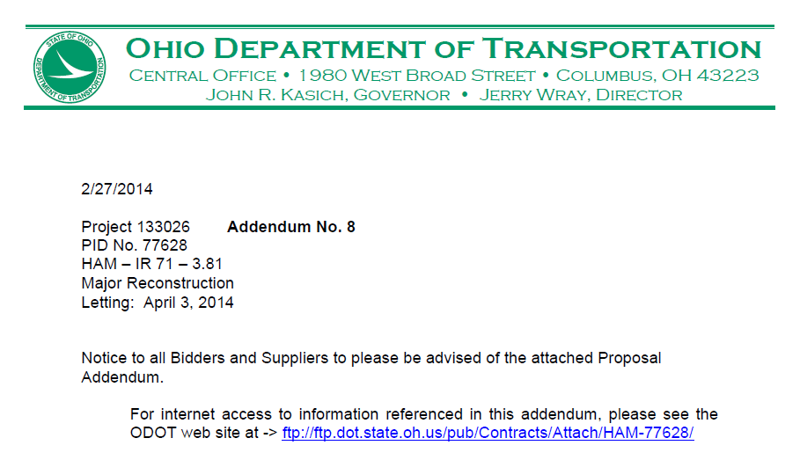
Notes:
Addendum coverletter example: Notice link to FTP site for attachments, like plan sheets.

Slide 31
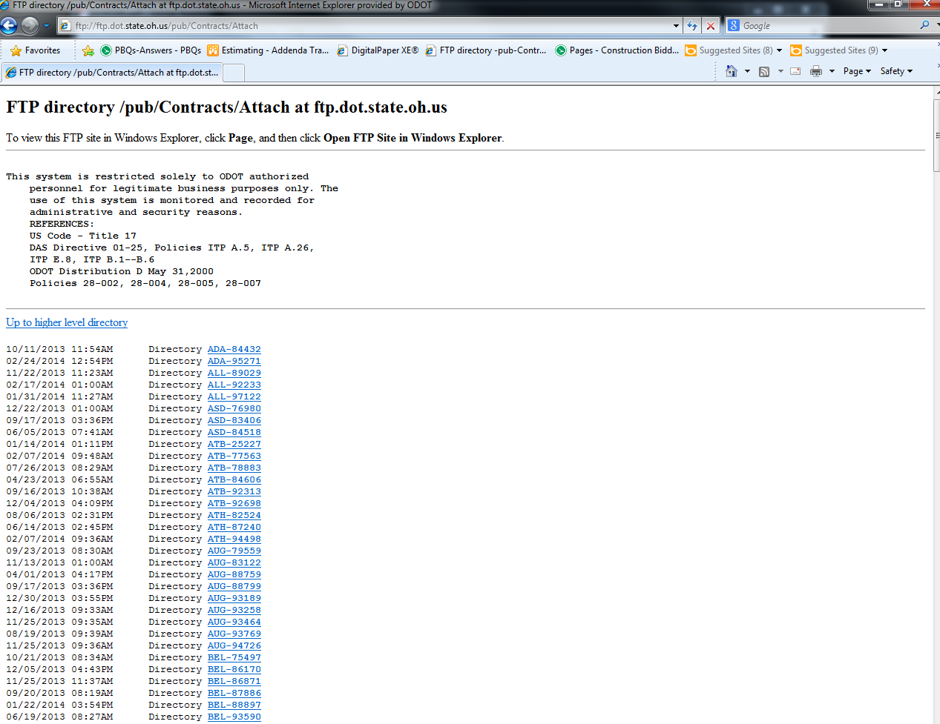
Notes:
FTP site. Sorted by 3 letter County abbreviation and PID
Refresh on browser to update every time you enter individual directory.

Slide 32
Questions?
Adam Kieffer
Construction Pre-Bid and Prequalification Coordinator
adam.kieffer@dot.state.oh.us
(614) 275-1310
http://www.transportation.ohio.gov/contracts

